Slide 1
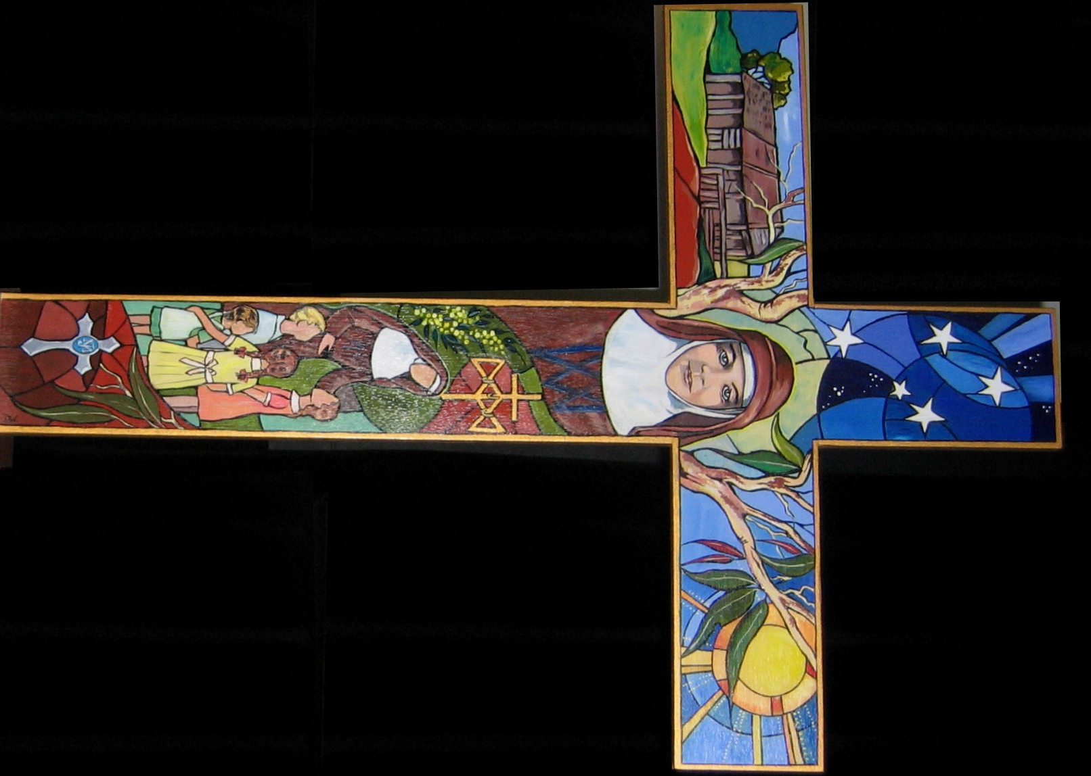
WELCOME
Artwork: Dorothy Woodward RSJ with permission.

Slide 2
Orientation and On-going Development
Into Josephite Ministry

Slide 3
Module 1: Josephite Charism/Values/Ethos
Contents
Module 1 : Josephite Charism/Values/Philosophy
1. Introduction
2. Healing/Caring/Teaching Mission of Jesus
3Julian Tenison Woods and Mary MacKillop
4. Charism – (Spirituality)
5. The Place of Joseph
6. Dignity for All Life and Especially People who have Fewer Choices.
Each section contributes to the overall understanding of the module. Each section consists of 4 parts
A tuning in activity which provides an individual and/or group experience on the topic;
2. how the topic relates to the Catholic tradition;
3. how the topic relates to Josephite charism or story and
4. an activity to integrate the ideas of the module into the life experience of the participants.

Slide 4
Module 1: Josephite Charism/Values/Ethos
Introduction
1. Introduction
2. Healing/Caring/Teaching Mission of Jesus
3. Julian Tenison Woods and Mary MacKillop
4. Charism- (Spirituality)
5. The Place of Joseph
6. Dignity for all Life and Especially People who have Fewer Choices.
In Module 1 you are introduced to Josephite charism, values and ethos.
Activities and materials in this module will help you to deepen:
your understanding of mission
your familiarity with Josephite story, values and ethos,
your application of Josephite values and ethos to practice and behaviour,
your Identification of how you currently experience and express Josephite values and ethos in your workplace.
your appreciation of how business can inform and supports Gospel values.
your awareness of the Gospel imperative to make life giving choices for all of creation.

Slide 5
Module 1: Josephite Charism/Values/Ethos
Introduction
KEY Values THAT ARE HALLMARKS OF JOSEPHITE SPIRITUALITY:
SIMPLICITY
  DOWN TO EARTH-NESS
PRACTICALITY
HUMILITY
HOSPITALITY
BEING “ONE’’ WITH OTHERS
KINDNESS
DIGNITY FOR ALL LIFE AND ESPECIALLY PEOPLE WHO HAVE FEWER CHOICES

Slide 6
Module 1: Josephite Charism/Values/Ethos
Introduction
Commodity Form of Consciousness | Personal (Gospel) Form of Consciousness
Value grounded in “Thinghood” | Value grounded in “personhood”
Thing Knowledge | Personal Knowledge
Thing- Willing | Personal- Willing
Thing- Behaviour | Person- Behaviour
Thing-like Affectivity | Personal Affectivity
Thing-Reality | Person-Reality
Table from Kavanaugh, J.F. (1988). Following Christ in a Consumer Society p.96-97.

Slide 7

Module 1: Josephite Charism/Values/Ethos
Introduction
At the heart of life God draws us into a new communion.
We believe that this is God’s invitation to the Congregation at this time.
Awakening anew to the creative vitality of our abundant and exuberant God,
we will immerse ourselves more consciously in the evolving mysteries
of the universe, of Earth, of humanity.
Sisters of St Joseph 26th General Chapter 2013
Image: Kenise Neill RSJ used with permission

Slide 8
Module 1: Josephite Charism/Values/Ethos
Introduction
We are invited to walk together contemplatively with open eyes, attentive to the violence and beauty, the wonder and heartache, the desolation and radiance in ourselves and beyond.
We hear the cry of Earth, the cry of children.
We feel humanity diminished.
Image: Kenise Neill RSJ used with permission Sisters of St Joseph
26th General Chapter 2013

Slide 9
Module 1: Josephite Charism/Values/Ethos
Introduction
We will respond as ecclesial women
in the spirit of Mary and Julian,
living on the edges of our existence with Joseph,
as we continue to re-imagine the gospel of Jesus, the Christ.
One with creation we are drawn into the new communion within an endlessly dynamic symphony of three movements: allurement, relationship and emergence.
Sisters of St Joseph
26th General Chapter 2013

Slide 10
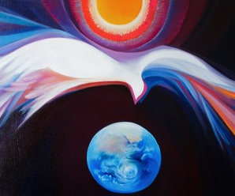
Module 1: Josephite Charism/Values/Ethos
Introduction
It is our belief that
many others besides
vowed sisters are gifted
with the same spirit.
Mary Southard CSJ with permission

Slide 11
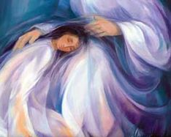
Module 1 : Josephite Charism/Values/Ethos
2.Healing/Caring/Teaching Mission of Jesus
Introduction
Healing/Caring/Teaching Mission of Jesus
Readings/sayings/letters from Julian Tenison Woods and Mary MacKillop
Josephite Spirituality (Charism)
The Place of Joseph
Dignity for all Life and Especially People who have Fewer Choices.
Mary MacKillop, Julian Tenison Woods and Josephites participate in God’s mission as expressed in the person of Jesus
Mary Southard CSJ with permission

Slide 12


Module 1 : Josephite Charism/Values/Ethos
2.Healing/Caring/Teaching Mission of Jesus
Mission
In the Beginning…
was the Mission.
And the Mission was with God
And the Mission was God
God who is Love.
The Mission does not belong to any Group
or Church or Religion.

Slide 13
God’s mission….
The Mission is of God,
of God alone.
The mission of God seizes
our imagination, possesses us..
and calls us to love God
and all people

Slide 14

Jesus’ mission
The Spirit of the
Lord is on me,
for he has anointed me
to bring the good news to the afflicted.
He has sent me to proclaim
liberty to captives,
sight to the blind,
to let the oppressed go free,
to proclaim the year of favour
from the Lord.
Luke 4:18-19
Vesica Piscis, Glastonbury

Slide 15

Church’s mission
The mission of God possesses the Church.

Slide 16


Module 1 : Josephite Charism/Values/Ethos
2.Healing/Caring/Teaching Mission of Jesus
Interview with Therese Carroll RSJ

Slide 17
Module 1 : Josephite Charism/Values/Ethos
2.Healing/Caring/Teaching Mission of Jesus
Interview with Fr David Ranson

Slide 18
Module 1 : Josephite Charism/Values/Ethos
2.Healing/Caring/Teaching Mission of Jesus
Questions for Reflection: (Attending the Spiritual moment)
Mission People
“People who refuse to be governed by fear
People who are willing to die for a cause
People who have something to live for
People with an appetite or passion for life” (Anthony J Gittens)
At a personal level- consider which of these conditions have become your strengths and which create difficulties for you and why?

Slide 19

2.Healing/Caring/Teaching Mission of Jesus
Module 1 : Josephite Charism/Values/Ethos
Article
Creative ministry- Henri Nouwen
Encyclical- Joy of the Gospel (Evangelii Gaudium) – Pope Frances
Decree on the Apostolate of the laity (Apostolicam actuosititem) Vat Council 2
Integrity in the service of the church

Slide 20

Module 1 : Josephite Charism/Values/Ethos
2.Healing/Caring/Teaching Mission of Jesus
The Beatitudes
For MAC Computers
What draws me closer to God? Away from God?
2. What helps me to become more a part of God’s realm (God’s way of being and doing) in my daily life? in my home life? at work?, in my community?, in the Meeting?, in the wider world?
3. In what ways am I called to challenge systems built on power, greed, oppression, falsehood, and exploitation of others and of the creation?

Slide 21
Module 1 : Josephite Charism/Values/Ethos
Healing/Caring/Teaching Mission of Jesus
The Beatitudes
For PC users
What draws me closer to God? Away from God?
2. What helps me to become more a part of God’s realm (God’s way of being and doing) in my daily life? in my home life? at work?, in my community?, in the Meeting?, in the wider world?
3. In what ways am I called to challenge systems built on power, greed, oppression, falsehood, and exploitation of others and of the creation?

Slide 22

Module 1 : Josephite Charism/Values/Ethos
2.Healing/Caring/Teaching Mission of Jesus
The Ten lepers Luke 17:11-19
The Good Samaritan Luke 10:25-37
The woman bent over Luke 13: m10-17
The woman at the well John 4: 4-26
Imagine yourself as one of the characters in the scripture story
How did you experience Jesus?
What values can you identify in this story?
What does this mean for you in your workplace?

Slide 23

Mission of Mary and Julian
“Seek first the poorest, most neglected parts of God’s vineyard”
Mary MacKillop 6th March 1900
“To relieve suffering and bring hope.”
Sisters of St Joseph Acts of Chapter 2001

Slide 24
God’s Mission
Jesus enters the Mission
Organisations and the
persons governing, leading or working in the ministries
The Church has the Sisters of St Joseph
The Mission has a Church

Slide 25
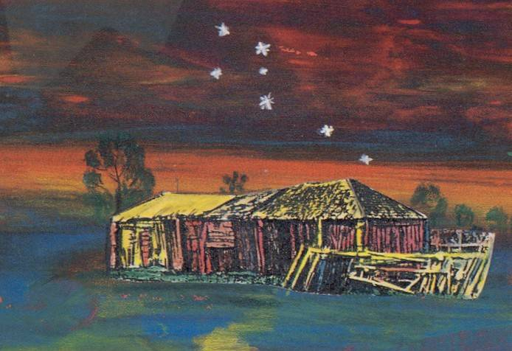
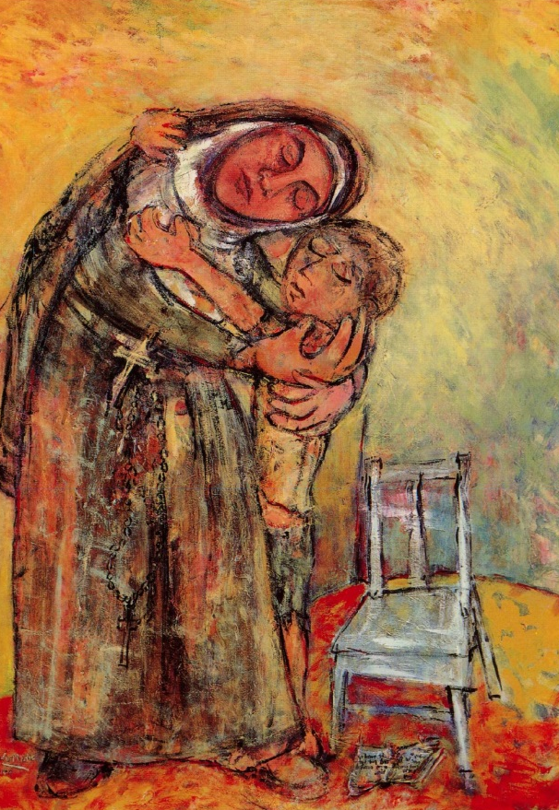
Mission is
The source of energy,
the vision that sustains
us,
the vision that
challenges us,
the vision that directs our services.

Slide 26
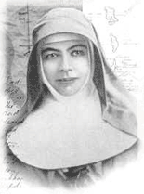
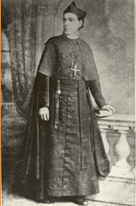
Mission is
the essence,
the central purpose of
all works in the name of the
Sisters of St Joseph
The basic raison d’etre
for our works.
“Mission implies movement.”
Anthony Gittens

Slide 27
Module 1 : Josephite Charism/Values/Ethos
2.Healing/Caring/Teaching Mission of Jesus
Questions for reflection
Shared and/or personal
Where have you experienced the healing caring and teaching mission of Jesus in your life?
How has this affected you and impacted on how you are in your work?
What is the place of your organisation/ministry in the Mission of God

Slide 28

Module 1 : Josephite Charism/Values/Ethos
2.Healing/Caring/Teaching Mission of Jesus
Something to pursue if you have an interest
Write a poem or a psalm
Declaration of Human rights
Create an artwork
Watch a movie “Babette’s Feast”, or “Eat, Love, Pray”
Read or see the movie :”Tuesdays with Morrie”. Mitch Albom

Slide 29
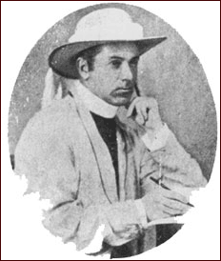
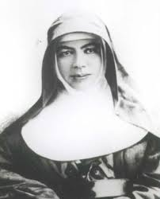
3. Julian Tenison Woods and Mary MacKillop
Module 1 : Josephite Charism/Values/Ethos
Introduction
Healing/Caring/Teaching Mission of Jesus
Julian Tenison Woods and Mary MacKillop
Charism (Spirituality)
The Place of Joseph
Dignity for all Life and Especially People who have Fewer Choices.

Slide 30
3. Julian Tenison Woods and Mary MacKillop
Module 1 : Josephite Charism/Values/Ethos
What do you know about Julian and Mary?
Have you joined the story?
When and why did you join the story?

Slide 31
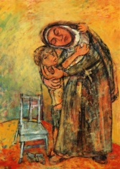
3. Julian Tenison Woods and Mary MacKillop
Module 1 : Josephite Charism/Values/Ethos
Who were Mary and Julian?
What were the values they espoused?
What attracts us to be part of this today?
How does our experience connect with their experience?

Slide 32
Module 1 : Josephite Charism/Values/Ethos
3. Julian Tenison Woods and Mary MacKillop
Introduction
Healing/Caring/Teaching Mission of Jesus
Readings/sayings/letters from Julian Tenison Woods and Mary MacKillop
Josephite Spirituality (Charism)
The Place of Joseph
Dignity for all Life and Especially People who have Fewer Choices
The Church and Society in the time of Julian and Mary

Slide 33
Module 1 : Josephite Charism/Values/Ethos
3.Julian Tenison Woods and Mary MacKillop
Joan Chittister, a contemporary theologian wrote that saints are
‘models of people who fire the soul of their own culture or who swim against the current and offer resistance where needed.’

Slide 34
Module 1 : Josephite Charism/Values/Ethos
3.Julian Tenison Woods and Mary MacKillop
Proclamation of canonisation – Mass booklet
http://www.rosebaydoverheightscatholics.com.au/blog/tony-blog/canonisation-of-mary-mackillop/
The gift of Julian Tenison Woods
http://www.sosj.org.au/news-events/view_article.cfm?id=2213&loadref=7

Slide 35
3.Julian Tenison Woods and Mary MacKillop
Module 1 : Josephite Charism/Values/Ethos
Scripture
Choose a reading and reflect on what it tells you about God’s mission
Letter on the Spirit of the Institute 1Peter 3: 8-15
Flowers of the fields, Birds of the air Matt 6:26-34
Micah’s theme 6:8
Whatsoever you do to the least Matt 25:40
Foxes have holes and the birds of the air nests Luke 9:58, Matt 8:20
Love is patient 1Cor. 13:4-7

Slide 36
3.Julian Tenison Woods and Mary MacKillop
Module 1 : Josephite Charism/Values/Ethos
An overview of the story
excerpts
“Soul of a Sunburnt Country” [version 2] “That very troublesome woman”
MaryMacKillop.org website
SOSJ.org website
MMK Penola Centre Site
Notes:
http://www.sosj.org.au/who-we-are/index.cfm?loadref=106 – JTW
http://www.sosj.org.au/who-we-are/index.cfm?loadref=105 – MMK
http://www.mackilloppenola.org.au/exhibitions/dsp-default.cfm?loadref=122 MMK Penola Centre

Slide 37
3.Julian Tenison Woods and Mary MacKillop
Module 1 : Josephite Charism/Values/Ethos
Selection of Mary MacKillop and Julian Tenison Woods Quotes and Art Work.
What do the quotes and art work tell us about Julian Tenison Woods and Mary MacKillop?

Slide 38
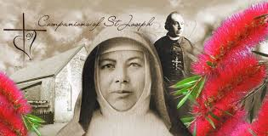
3.Julian Tenison Woods and Mary MacKillop
Module 1 : Josephite Charism/Values/Ethos
“Seek first the poorest and most neglected parts of God's vineyard”. (1900) MMK

Slide 39
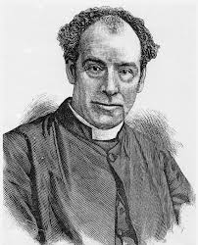
3.Julian Tenison Woods and Mary MacKillop
Module 1 : Josephite Charism/Values/Ethos
“Sisters of St Joseph must have great courage, a courage that rises in difficulties and obstacles instead of being lessened by them.”

Slide 40
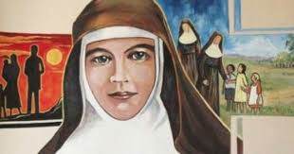
3.Julian Tenison Woods and Mary MacKillop
Module 1 : Josephite Charism/Values/Ethos
“Never be ashamed of work done for God and God's poor” (1874) MMK

Slide 41
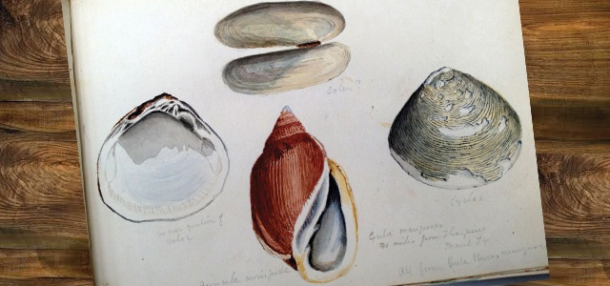
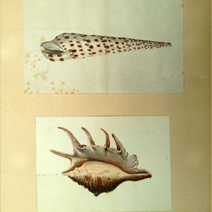
3.Julian Tenison Woods and Mary MacKillop
Module 1 : Josephite Charism/Values/Ethos
“Be kind to all, be gentle to all, be very gentle”.

Slide 42
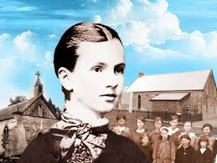
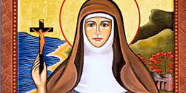
3.Julian Tenison Woods and Mary MacKillop
Module 1 : Josephite Charism/Values/Ethos
“We must love to be hidden and not shrink from being despised and go on in our simple way trusting in God”. (Circular 9 September 1887)
“We must try to make (humanity) better by the example of St Joseph”. (Circular 4 September 1887)

Slide 43
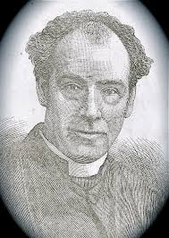
3.Julian Tenison Woods and Mary MacKillop
Module 1 : Josephite Charism/Values/Ethos
“Let us wait patiently for God to unfold ‘his’ designs and let us not fear to be too indulgent to ourselves in thus trusting him”.
“Let us wait, not like the child who dances impatiently while its bread and butter is being cut, let us confide lovingly in him – let us wait patiently until God unfolds ‘his’ designs.”

Slide 44
3.Julian Tenison Woods and Mary MacKillop
Module 1 : Josephite Charism/Values/Ethos
Questions for reflection
Shared and/or personal
Thinking about what you know about Mary MacKillop and Julian Tenison Woods and translating it into our contemporary lives - what do you find inspiring and how is/ or could that impact on your life?
Critique your current place of work in the light of Mary and Julian’s spirituality. What actions does this inspire you to take?
What particular aspect of either Julian or Mary’s spirituality would you like to depth in your own life?

Slide 45
3.Julian Tenison Woods and Mary MacKillop
Module 1 : Josephite Charism/Values/Ethos
Questions for reflection – (Attending the Spiritual moment)
What aspect of God’s mission that JTW and MMK engaged in inspires you to be in partnership with the vision today?
How do you make a difference in the world today?

Slide 46
3.Julian Tenison Woods and Mary MacKillop
Module 1 : Josephite Charism/Values/Ethos
Something to pursue if you have an interest
Write a letter to Mary or Julian
Visit one of the SOSJ Mary MacKillop centres
http://www.sosj.org.au/where-we-are/index.cfm?loadref=303
In the Land of Larks and Heroes: Australian reflections on St Mary MacKillop edited by Alan H. Cadwallader
An Extraordinary Australian – Paul Gardner
No Ordinary Man: Life and letters of Julian E. Tenison Woods – Isabel Hepburn
Fr Julian Tenison Woods Fr Founder by MMK introduced and annotated by Margaret Press
Julian Tenison Woods – Margaret Press
Ten Years in the Bush – Anne V. Player
Symphony of life – Anne V. Player
Wallaby Track Woman- multiple authors
Find out about some other Josephites – SOSJ website
A Nest of Crosses - Letters between Mary and Julian – Sheila McCreanor Excerpts pp271-285.
Resource book 3 Excerpts pp. 3-9 and “The Spirit of the Institute” pp 64-72
Mary and Julian Their Letters 1862 to 1868 pp.20-21; 31- 36

Slide 47

Julian Tenison Woods and Mary MacKillop
Module 1 : Josephite Charism/Values/Ethos
Check your understanding (optional)
Options:
SOSJ website
Visit a Josephite incorporated work or ministry other than your own
Talk to a Josephite
Research Mary MacKillop
Notes:
(pictures of hero/ines)

Slide 48
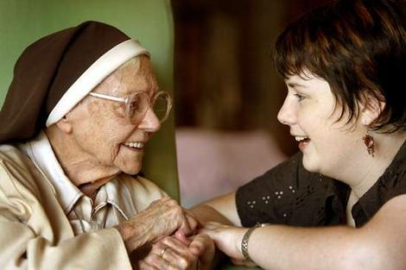
Module 1 : Josephite Charism/Values/Ethos
4. Charism (Spirituality)
Introduction
Healing/Caring/Teaching Mission of Jesus
Readings Sayings/Letters from Julian Tenison Woods and Mary MacKillop
Charism- (Spirituality)
The Place of Joseph
Dignity for all Life and Especially People who have Fewer Choices
Sister Olave Walsh (dec) and Sister Anne-Marie Gallagher (Teacher)
Notes:
Image
Introductory Text
Next 3 slides
Activity (include icons)
Eg:
Reading
Videos
Scripture
Articles
Encyclicals
Questions for reflection
Shared and/or personal
Something to pursue if you have an interest
Check your understanding

Slide 49
Module 1 : Josephite Charism/Values/Ethos
4. Charism (Spirituality)
What is Charisma? Charlie Gandy @ TED talks
http://tedxtalks.ted.com/video/TEDxSoCal-Charlie-Gandy-Creatin
Think of someone with Charisma

Slide 50
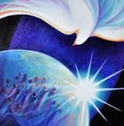
“To each person
the manifestation of the Spirit
is given
for the common good.” (1 Cor 12:7)
Mary Southard CSJ with permission

Slide 51
Understanding Spirituality
Module 1 : Josephite Charism/Values/Ethos
4. Charism (Spirituality)
David Ranson in his book “Across The great
Divide” says that because spirituality is linked
to consciousness, it follows that same pattern
as when we bring thought to consciousness.
It is a ‘process’
Notes:
Before we can define spiritualty we have to understand what it is

Slide 52
CYCLE OF SPIRITUALITY
Module 1 : Josephite Charism/Values/Ethos
4. Charism (Spirituality)
Ranson says that spirituality is also cyclic in
nature, since different aspects of life, environment
and personality impact upon it and therefore it
continually develops.
So it is a living thing – not something that is “there”

Slide 53
Module 1 : Josephite Charism/Values/Ethos
4. Charism (Spirituality)
This process has been described by Bernard Lonegan
in the following way:
First of all, there is recognition that something
is catching our attention
Secondly, we give greater awareness to this beckoning
Third, we interpret the meaning that is emerging,
weighing it up against what we know already,
aligning it with experience
Fourthly, we give shape to the thought. It takes on its own life.

Slide 54
Module 1 : Josephite Charism/Values/Ethos
4. Charism (Spirituality)
Questions for Reflection
(Attending the Spiritual moment)
Describe a personal experience that has led you to a strong connection with a Gospel value?
The way you responded to that experience - the transformative moment -is an expression of your spirituality.

Slide 55
Charism (Greek – “gift”)
Module 1 : Josephite Charism/Values/Ethos
4. Charism (Spirituality)
a gift of the Spirit
given to persons
and taken up by a group
to carry out the mission of Jesus,
serving with a special spirit
which tells us something special
about God.
(Mary Cresp RSJ)
Notes:
We often talk about the Charism of religious order. Each having their own “gift” / flavours

Slide 56
Module 1 : Josephite Charism/Values/Ethos
4. Charism (Spirituality)
Charism is the heart of the founder aglow at one period in history beating in on us in another day and age ... Charism is tree, branch, flower, fruit.
An ever-changing, always rooted obsession
For the coming reign of God, where the reign of God is needed most,
One that develops from age to age
And then grows up in a new way in the next one.
Charism is a living passion for whatever dimension of the life of Christ ...
peace, truth, healing, mercy ... is missing now.
Here, in our time. Where we are.
(Joan Chittister )
Charism is always at the service of mission.

Slide 57
Module 1 : Josephite Charism/Values/Ethos
4. Charism (Spirituality)
Scripture
I have come that you may have life and have it to the full (John 10:10)
The Spirit of the Lord has been given to me (Luke 4:13-19)
The Emmaus story (Luke 24)
Washing of the feet (John 13:1-17)
The vine and the branches (John 15)

Slide 58
Module 1 : Josephite Charism/Values/Ethos
4. Charism (Spirituality)
"Having a global heart is not an option for Sisters of St Joseph. It is who we are." (Carol Zinn, SSJ Philadelphia)
Mary MacKillop believed that God was active in her life and in the lives of her early companions and was calling them to the service of others.. Excerpt from the SOSJ constitutions Ch2:4
Notes:
"Having a global heart is not an option for Sisters of St Joseph. It is who we are." (Carol Zinn, SSJ Philadelphia)
Mary MacKillop believed that God was active in her life and in the lives of her early companions and was calling them to the service of others. She expressed her trust in the loving Providence of God our Father by founding a Congregation which was dependent on Providence for its support and was devoted to the service of the poor. Its members were women who worked in a simple ordinary way to bring to the poor the message of their human dignity and of Christ’s saving love. Excerpt from the SOSJ constitutions Ch2:4

Slide 59


Module 1 : Josephite Charism/Values/Ethos
4. Charism (Spirituality)
The Josephite Emblem-
Notes:
Before we can define spiritualty we have to understand what it is.
Click on emblem to take you to explannation

Slide 60
Module 1 : Josephite Charism/Values/Ethos
4. Charism (Spirituality)
“Josephite” Charism
Translated into ‘non-religious’ language
Incarnational (God in our world)
  “ordinary”, “roll-your-sleeves-up approach”, hospitality, practicality, “being with” the other, simplicity, humility, no fan-fare, serving God in our neighbour.
The Community of
God’s Great (compassionate) Love
These characteristics are not exclusive to Josephites
  but… they ARE Josephite!

Slide 61
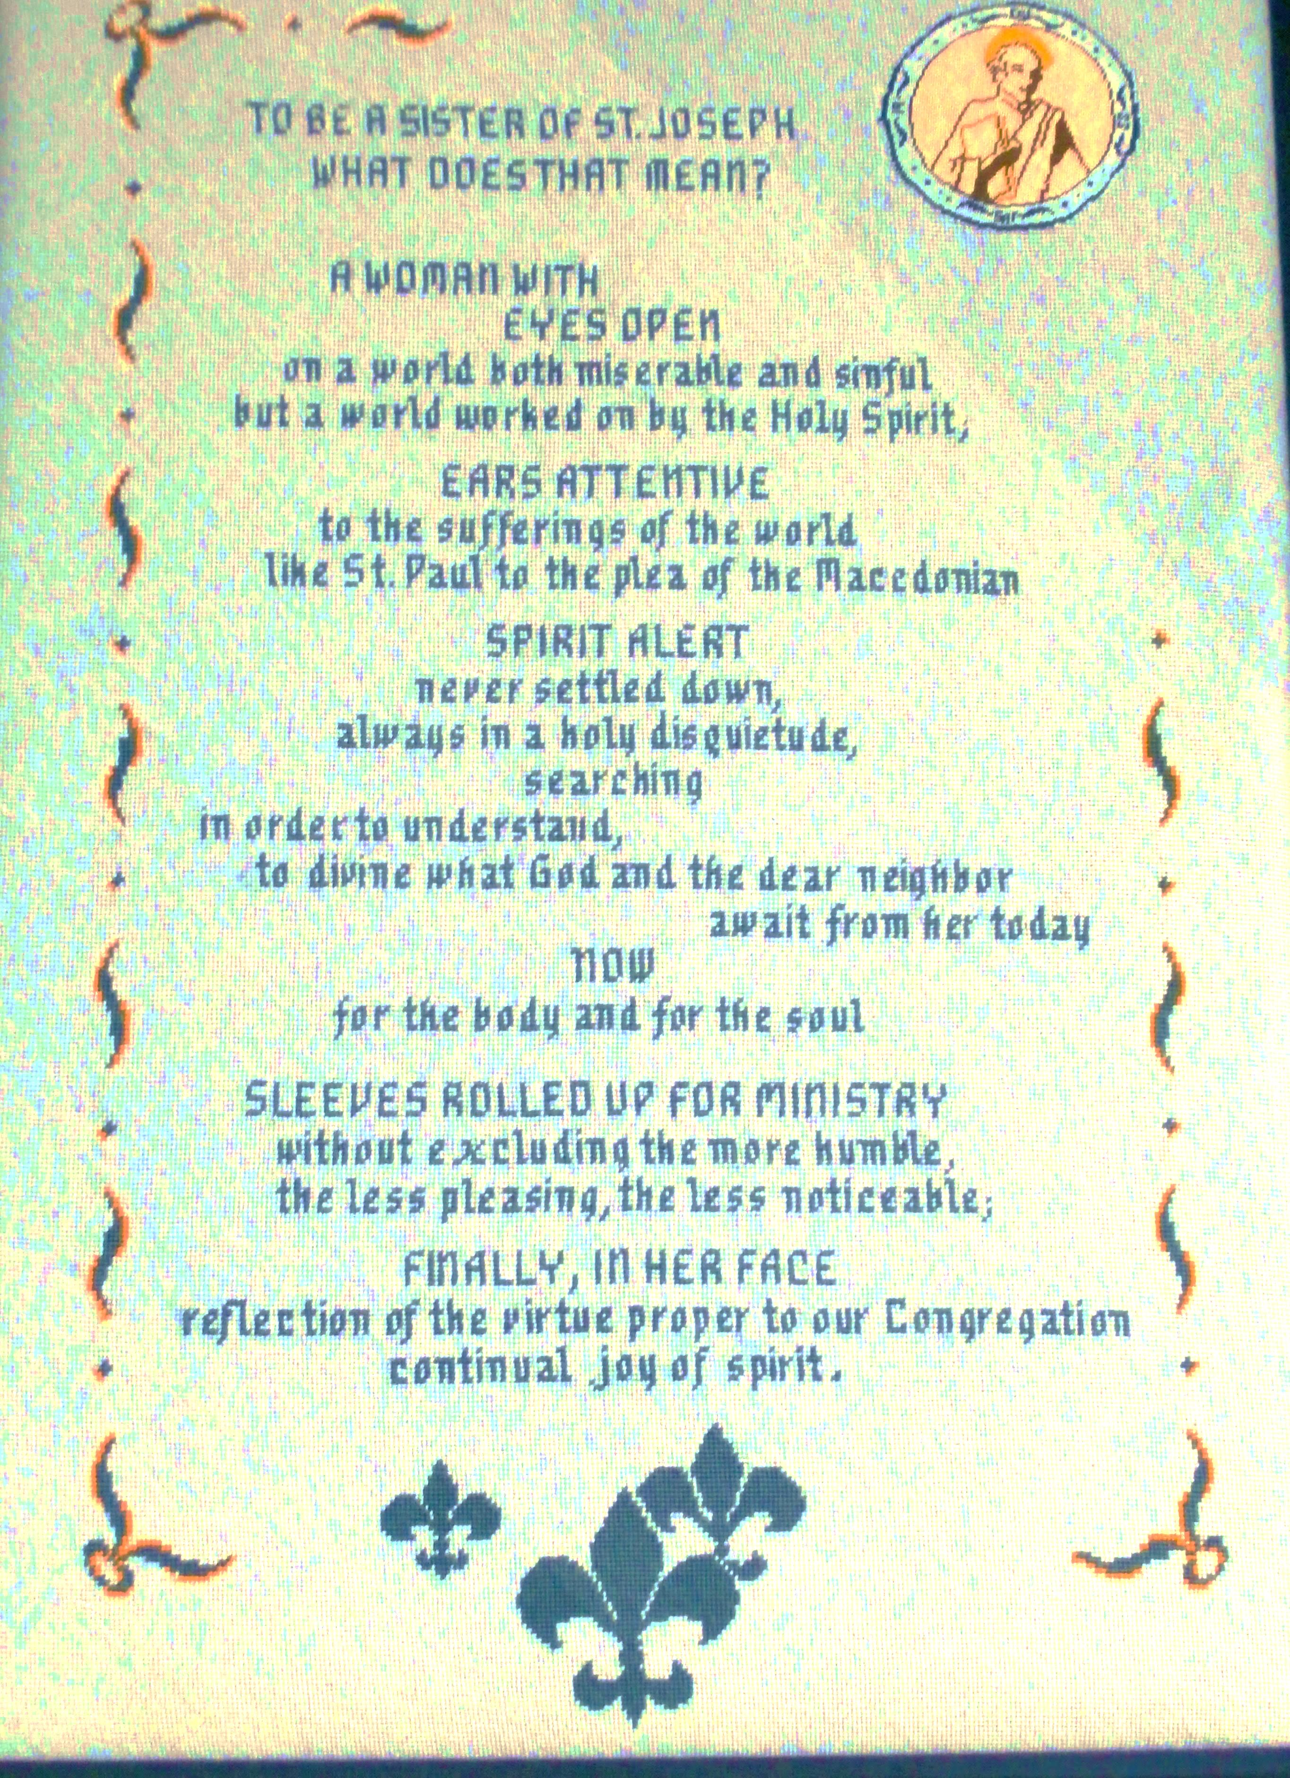
To be a Sister of St Joseph
What does that mean?
A woman with
EYES OPEN
In a world both miserable and sinful.
But a world marked on by the Holy Spirit
EARS ATTENTIVE
to the sufferings of the world
Iike St Paul to the plea of the MacedonianMacedonian
SPIRIT ALERT
Never settled down
Always in a holy disquietude
Searching
In order to understand
To divine what God and the dear neighbour
await from her today
NOW
For the body and for the soul
SLEEVES ROLLED UP FOR MINISTRY
Without excluding the more humble
The less pleasing the less noticeable;
FINALLY, IN HER FACE
Reflection of the virtue proper to our Congregation
Continual joy of the spirit.
Notes:
If you choose to also include the Maxims from Le Peuy the following is background:
With this in mind the Jesuit founder,
Jean-Pierre Medaille developed 100 maxims based
on the values and virtues contained in the gospel. They were memorized by both the sisters and the laity
as a means of deepening their spirituality. Today they continue to be a source of inspiration for many.
(Maxims available in package of readings)

Slide 62
Module 1 : Josephite Charism/Values/Ethics
4. Charism (Spirituality)
SOSJ Website – what we are doing http://www.sosj.org.au/what-we-are-doing/index.cfm?loadref=3
Song – Gathering - Christina Nuenzerling, Anne-Marie Wilkinson and Mary Fletcher.

Slide 63
Module 1 : Josephite Charism/Values/Ethics
4. Charism (Spirituality)
Living the Dream
With Josephite Passion
What do those with the Josephite spirit look like today?

Slide 64
Module 1 : Josephite Charism/Values/Ethos
4. Charism (Spirituality)
What does it mean for YOU
to be working in a Josephite ministry?

Slide 65

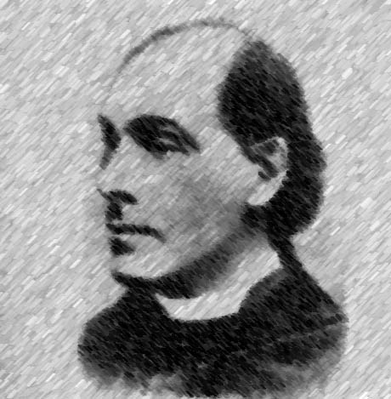
Module 1 : Josephite Charism/Values/Ethos
4. Charism (Spirituality)
Mary MacKillop
Julian Tenison Woods
What values do you see your colleagues putting into practice that are an embodiment of the Josephite spirit?

Slide 66
Module 1 : Josephite Charism/Values/Ethos
4. Charism (Spirituality)
Something to pursue if you have an interest
Explore the SOSJ website
Breathing under water - Richard Rohr
Maxims of St Joseph
God’s mission – Mary Cresp page 1 CentreWest Ministry Profile 2013/2014
The Spirit of Joseph (book) – Mary Cresp

Slide 67
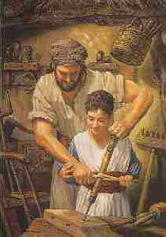
Module 1 : Josephite Charism/Values/Ethos
5. The Place of Joseph
Introduction
Healing/Caring/Teaching Mission of Jesus
Readings/sayings/letters from Julian Tenison Woods and Mary MacKillop
Josephite Spirituality (Charism)
The place of Joseph
Dignity for all Life and Especially People who have Fewer Choices
Notes:
Image
Introductory Text
Activity (include icons)
Eg:
Reading
Videos
Scripture
Articles
Encyclicals
Questions for reflection
Shared and/or personal
Something to pursue if you have an interest
Check your understanding

Slide 68
Module 1 : Josephite Charism/Values/Ethos
5. The Place of Joseph
What do you know about Joseph?
Notes:
Image
Introductory Text
Activity (include icons)
Eg:
Reading
Videos
Scripture
Articles
Encyclicals
Questions for reflection
Shared and/or personal
Something to pursue if you have an interest
Check your understanding

Slide 69
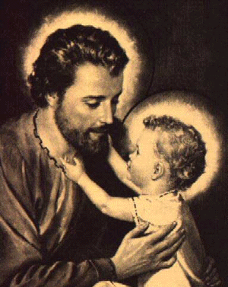
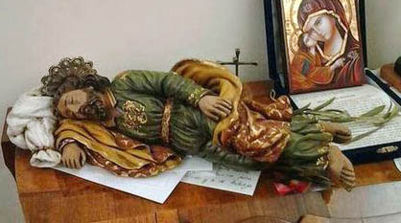
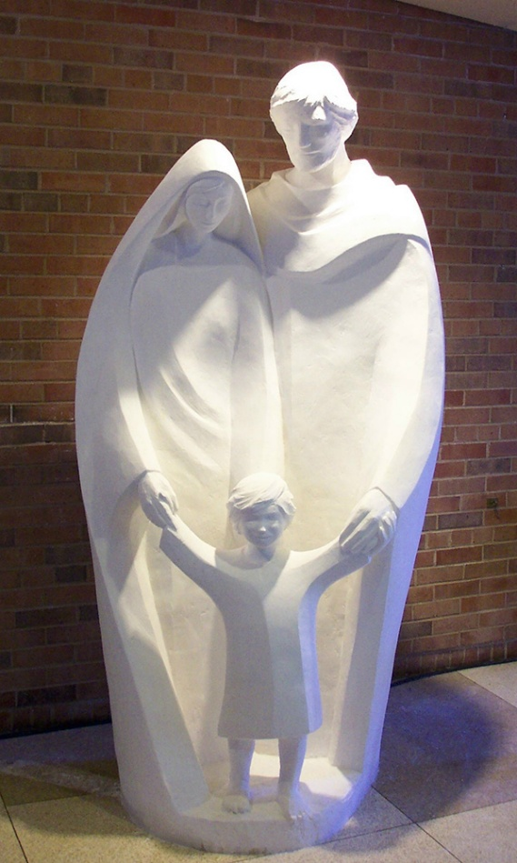
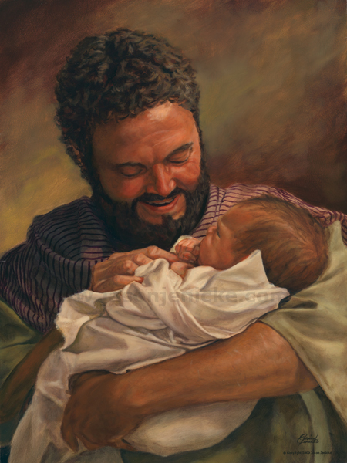
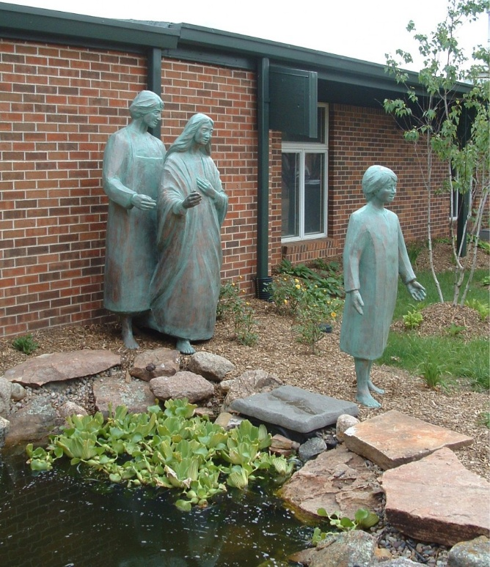
Mary Southard with permission
Notes:
Play Joseph by Peter Kearney – Album Celebration
Image
Introductory Text
Activity (include icons)
Eg:
Reading
Videos
Scripture
Articles
Encyclicals
Questions for reflection
Shared and/or personal
Something to pursue if you have an interest
Check your understanding

Slide 70
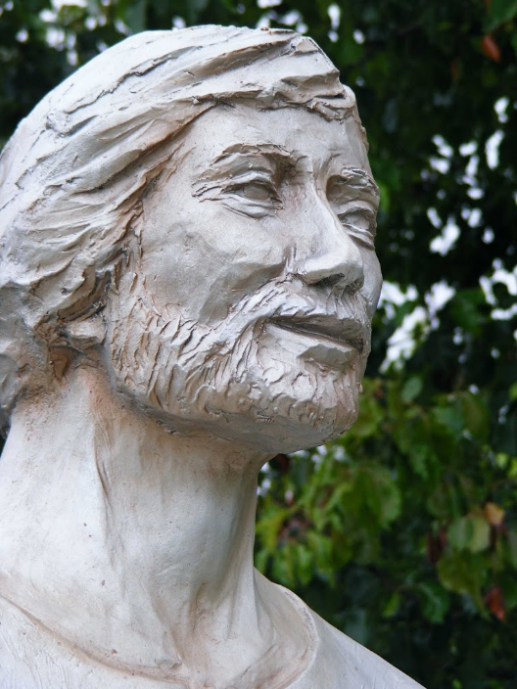
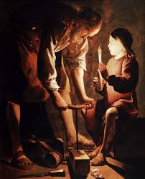
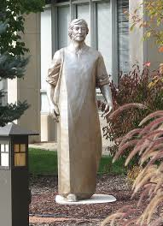
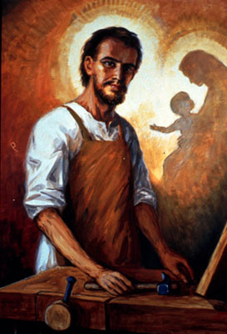
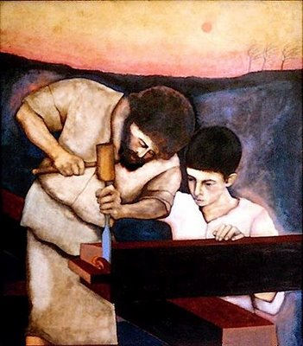
Mary Southard with permission
Mary Southard with permission
Notes:
Image
Introductory Text
Activity (include icons)
Eg:
Reading
Videos
Scripture
Articles
Encyclicals
Questions for reflection
Shared and/or personal
Something to pursue if you have an interest
Check your understanding

Slide 71
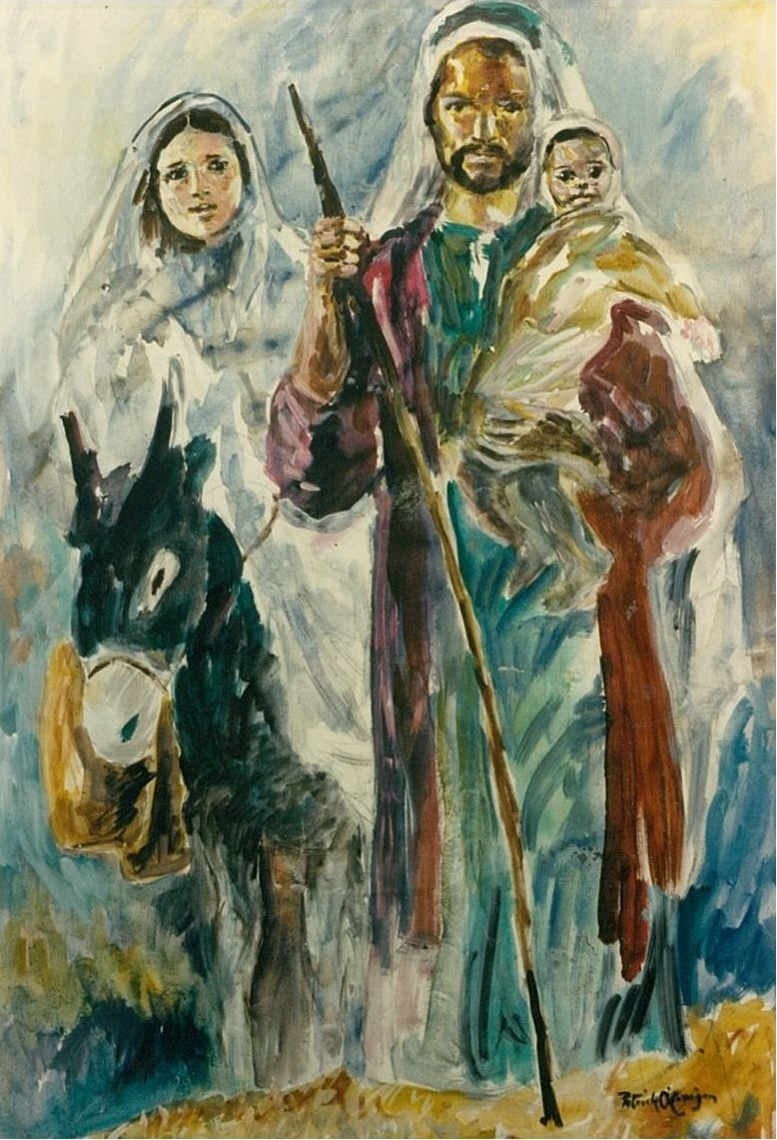
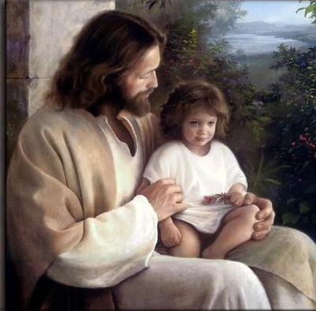
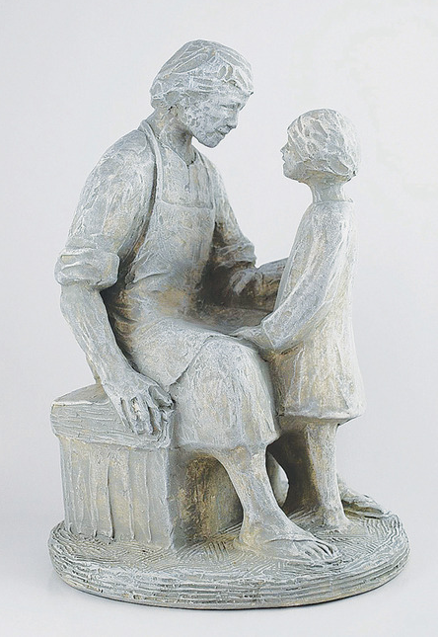
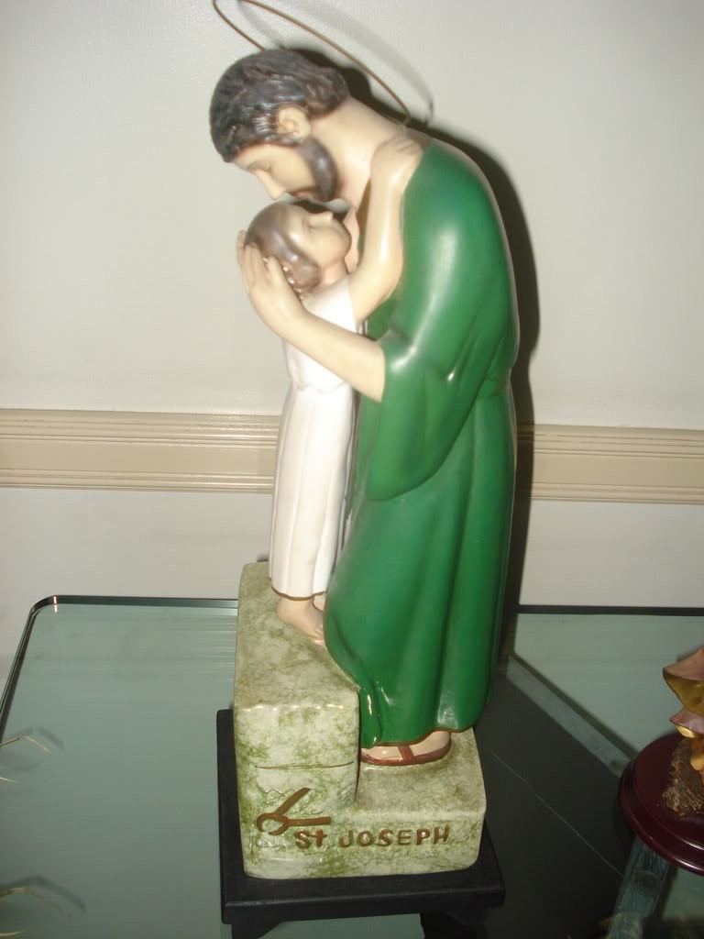
(Patrick O Carrigan MSC used with permission)
Mary Southard with permission

Slide 72
Module 1 : Josephite Charism/Values/Ethos
The Place of Joseph
What is my response to the images we have seen?
What do you love about Joseph?
Notes:
Image
Introductory Text
Activity (include icons)
Eg:
Reading
Videos
Scripture
Articles
Encyclicals
Questions for reflection
Shared and/or personal
Something to pursue if you have an interest
Check your understanding

Slide 73
Module 1 : Josephite Charism/Values/Ethos
The place of Joseph
Scripture
Matt. 1:16 Jacob the father of Jesus
Matt:1:20-21 an Angel appeared to Joseph
Matt 2:13;14-15 Escape to Egypt
Luke 2: 41-51 Jesus lost in the temple

Slide 74
Module 1 : Josephite Charism/Values/Ethos
The Place of Joseph
Articles
Mary Dunns article [printed copies available]
Encyclicals:
Apostolic Exhortition Redemptoris Custos – On the Person and Mission of St Joseph in the life of Christ and the Church. John Paul II
Pope Francis – Homily March 19th 2014

Slide 75

Module 1 : Josephite Charism/Values/Ethos
The Place of Joseph
Reading
St Joseph – Perrotta p29 (Mary Cresps book p 43)
The ordinariness of Joseph – Mary Cresps book p. 99, ff 102
Partnership with God Mary Cresp p 230
Mary Cresp p 182

Slide 76
Module 1 : Josephite Charism/Values/Ethos
The Place of Joseph
Joseph is the patron of workers. He is offered too as a model of fathers. Mary and Julian chose Joseph as a model because he was hidden, humble, caring, protecting, and confident in God.
“We will respond as ecclesial women in the spirit of Mary and Julian, living on the edges of our existence with Joseph, as we continue to re-imagine the gospel of Jesus, the Christ” (26th Chapter 2013).
Sculpture Mary Southard with permission
Notes:
During the middle ages, the figure of Joseph as patron became popular especially among ordinary folk struggling to survive in times of war, plague and famine. In a society which had begun to organise craftsmen into guilds, the forerunners of unions, identification with Joseph the artisan was a natural step. Joseph is the patron of workers. He is offered too as a model of fathers. Mary and Julian chose Joseph as a model because he was hidden, humble, caring, protecting, and confident in God.
“We will respond as ecclesial women in the spirit of Mary and Julian, living on the edges of our existence with Joseph, as we continue to re-imagine the gospel of Jesus, the Christ” (26th Chapter 2013).

Slide 77
Module 1 : Josephite Charism/Values/Ethos
The Place of Joseph
25 years ago, we first kept up St Joseph’s Day as the special Feast of our proposed Institute and little did either of us then dream of what was to spring from so small a beginning.
(“Mary MacKillop on Mission to her Last breath” arranged and edited by Sheila McCreanor rsj, page146)
Notes:
“25 years ago, we first kept up St Joseph’s Day as the special Feast of our proposed Institute and little did either of us then dream of what was to spring from so small a beginning. First we had Mass and Holy Communion in the church and then a feast for the schoolchildren. On that day was our glorious Patron first honoured as Patron of little children, and our work committed to his care. Our poor Father (Woods) was happy that day and so was I, but we said little beyond wondering whom God would call to assist us and how He would make the way clear.” (“Mary MacKillop on Mission to her Last breath” arranged and edited by Sheila McCreanor rsj, page146)

Slide 78
Module 1 : Josephite Charism/Values/Ethos
The Place of Joseph
Quote from Mary MacKillop on Mission to her last breath by Shiela McCreanor RSJ page 49
Quotes from MMK writing about Joseph

Slide 79
Module 1 : Josephite Charism/Values/Ethos
The Place of Joseph
Reading and Reflection
The Vocation and mission of Joseph and Mary – Paul Molinari and Anne Hennessy pg 12 (“In the Spirit of Joseph”- Mary Cresp p42)
Reflect on times you have experienced this tension between law and Spirit and what influenced your decision making.

Slide 80
Module 1 : Josephite Charism/Values/Ethos
The Place of Joseph
Questions for reflection
(Attending the spiritual moment)
Reflecting on St Joseph, what is my response? And what is that about?
How does it feel?
Is there an image that describes my feelings?
Is there any aspect of St Joseph that relates to my life? In what ways?
Write a poem or prayer or a visual response.
(Patrick O Carrigan MSC used with permission)

Slide 81
Module 1 : Josephite Charism/Values/Ethos
The Place of Joseph
Something to pursue if you have an interest
The Vocation and mission of Joseph and Mary – Paul Molinari and Anne Hennessy
The Spirit of Joseph- Mary Cresp
Write a prayer to St Joseph
Ask a school or organisation that has chosen St Joseph as their patron how that is expressed in their organisation?
Movie length movie Joseph of Nazareth https://www.youtube.com/watch?v=L70K_kWwLmY
Video clips – see below
Pope Francis and St Joseph http://en.radiovaticana.va/news/2015/04/30/pope_francis_saint_joseph_and_the_dignity_of_labour_/1140861

Slide 82
Module 1 : Josephite Charism/Values/Ethos
The Place of Joseph
(For MAC Computer)
The life of Joseph

Slide 83
Module 1 : Josephite Charism/Values/Ethos
The Place of Joseph
[For PC computer]
The life of Joseph

Slide 84
Module 1 : Josephite Charism/Values/Ethos
The Place of Joseph
Check your understanding (optional)
Scenarios and choose the Josephite response – multiple choice quiz
Create presentation for your staff group or a colleague
Create a visual representation of your learning
Write a poem/song/prayer or psalm

Slide 85
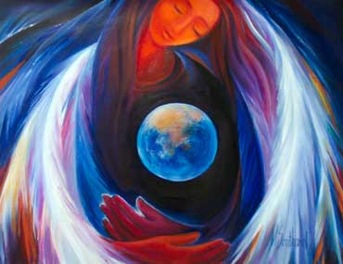
6. Dignity for all Life and Especially People who have Fewer Choices
Module 1: Josephite Charism/Values/Ethos
1. Introduction
2. Healing/Caring/Teaching Mission of Jesus
3. Julian Tenison Woods and Mary MacKillop
4. Josephite Spirituality (Charism)
5. The Place of Joseph
6. Dignity for all Life and Especially People who have Fewer Choices
Mary Southard CSJ used with permission
Notes:
Listen to the song – “Something Special” from Josephite Dreaming

Slide 86
6. Dignity for all Life and Especially People who have Fewer Choices
Module 1: Josephite Charism/Values/Ethos
Landfill Harmonic Orchestra

Slide 87
6.Dignity for all Life and Especially People who have Fewer Choices
Module 1: Josephite Charism/Values/Ethos
She’s alive……… beautiful……. finite…worth dying for….

Slide 88
6.Dignity for all Life and Especially People who have Fewer Choices
Module 1: Josephite Charism/Values/Ethos
As you listen to the song what words are particularly significant for you in your role?

Slide 89


We of the Earth, we of the spirit
born in perfection, in nature entwined
form and creation, encoded within us
lifetimes in cycle, on pathways of time
Now we have arrived, at the age of the golden
but we stand divided, and we have forgotten
From the dawn of creation, to the day of the rainbow
we of the spirit, are born of the Earth.
(Jeff Clarkson)
And Earth is our home
our only home
in an hour of time
a moment goes by
what have we done?
Earth is our home
our only home
sea creatures, the trees
the mountains, the seas
to this we belong.
Now the tide it has turned
and the feelings we've found
when we hurt the Earth
we're hurting ourselves,
Earth is our home. (Repeat).

Slide 90
6.Dignity for all Life and Especially People who have Fewer Choices
Module 1: Josephite Charism/Values/Ethos
Interview with Denis Edwards
(F or MAC Computers)
1. What is the connection between creation and Jesus for you?
2. What kind of ecological action is needed from a Christian perspective?
3. How does this impact on the decisions you make in your workplace?

Slide 91
6.Dignity for all Life and Especially People who have Fewer Choices
Module 1: Josephite Charism/Values/Ethos
Interview with Denis Edwards
[For PC users]
1. What is the connection between creation and Jesus for you?
2. What kind of ecological action is needed from a Christian perspective?
3. How does this impact on the decisions you make in your workplace?

Slide 92
6.Dignity for all Life and Especially People who have Fewer Choices
Module 1: Josephite Charism/Values/Ethos
Readings
Polarisation and justice – why evolving consciousness matters – Sue Wilson CSJ RSJ Resources
Why the excluded are still waiting – John Falzon http://www.eurekastreet.com.au/article.aspx?aeid=41631#.VGgljpVxm1t

Slide 93

6.Dignity for all Life and Especially People who have Fewer Choices
Module 1: Josephite Charism/Values/Ethos
Preferential Option for the Poor
We live in an amazing world with enough resources for everyone. Yet, many miss out.
Read more
http://www.caritas.org.au/learn/catholic-social-teaching

Slide 94

6.Dignity for all Life and Especially People who have Fewer Choices
Module 1: Josephite Charism/Values/Ethos
Dignity of the Human Person
We are made in God’s image. This means we each have a God-given dignity.
Read more
http://www.caritas.org.au/learn/catholic-social-teaching

Slide 95

6.Dignity for all Life and Especially People who have Fewer Choices
Module 1: Josephite Charism/Values/Ethos
Stewardship of Creation
We are responsible for looking after the world we live in.
Read more
http://www.caritas.org.au/learn/catholic-social-teaching

Slide 96

6.Dignity for all Life and Especially People who have Fewer Choices
Module 1: Josephite Charism/Values/Ethos
Subsidiarity and Participation
The role of people in positions of power is to look after the good of all.
Read more
http://www.caritas.org.au/learn/catholic-social-teaching

Slide 97

6.Dignity for all Life and Especially People who have Fewer Choices
Module 1: Josephite Charism/Values/Ethos
The Common Good
We can only live life in all its fullness when we are in relationship with others – through community.
Read more
http://www.caritas.org.au/learn/catholic-social-teaching

Slide 98

6.Dignity for all Life and Especially People who have Fewer Choices
Module 1: Josephite Charism/Values/Ethos
Solidarity
We should commit ourselves wholeheartedly to the good of all, to stand in solidarity with our one human family.
Read more
http://www.caritas.org.au/learn/catholic-social-teaching

Slide 99
6.Dignity for all Life and Especially People who have Fewer Choices
Module 1: Josephite Charism/Values/Ethos
Pope Francis urges business leaders to serve human dignity, common good
Encyclicals
Pope Frances on the Environment
Draft document from the synod on the family
Pope Paul VI
Octogesima Advenines (May 5th 1971)
Populorum Progressio (1967) http://www.papalencyclicals.net/Paul06/p6develo.htm
Pope Leo
Rerum Novarum (1891)

Slide 100
6.Dignity for all Life and Especially People who have Fewer Choices
Module 1: Josephite Charism/Values/Ethos
Scripture
The Lord hears the cry of the poor Psalms 69:33, 12:5, 22:24, 68:6, Jeremiah 20:13
He sent me to bring good news to the poor Luke 4:18
Come blessed of my Father Matt 25: 34-46

Slide 101

6.Dignity for all Life and Especially People who have Fewer Choices
Module 1: Josephite Charism/Values/Ethos
At the heart of life God draws us into a new communion.
We are invited to walk together contemplatively with open eyes, attentive to the violence and beauty, the wonder and heartache, the desolation and radiance in ourselves and beyond. We hear the cry of Earth, the cry of children. We feel humanity diminished. (RSJ Chapter document 2013)
Image: Kenise Neill RSJ used with permission

Slide 102
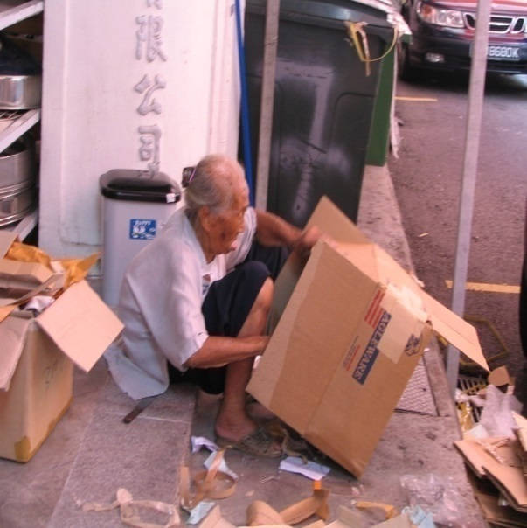
6.Dignity for all Life and Especially People who have Fewer Choices
Module 1: Josephite Charism/Values/Ethos
Mary and Julian's original dream- ‘Charism” was to set up schools, providences, and orphanages and to reach out to address:
ignorance,
godlessness and
human misery.

Slide 103
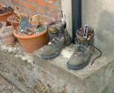
6. Dignity for all Life and Especially People who have Fewer Choices
Module 1: Josephite Charism/Values/Ethos
Mary seemed to have the capacity to “stand in the shoes” of another.
This great gift empowered her with vision, empathy and compassion.
Her sensitive awareness of what it must be like to experience distress, neglect, indignity left her no choice but to identify with the sufferer and offer them the opposite of what was being experienced.

Slide 104
6.Dignity for all Life and Especially People who have Fewer Choices
Module 1: Josephite Charism/Values/Ethos
Our Congregation….was founded …. to respond to the ‘misery and wretchedness’ of the ‘bush children’ and the ‘aﬄicted poor’.
This they did by making the Catholic education of poor children the Sisters’ prime task and by undertaking urgently needed works of charity for which no other religious were available. (Excerpt from SOSJ Constitutions)
Notes:
Our Congregation, the Sisters of St Joseph of the Sacred Heart, is a religious Congregation of Pontiﬁcal right dedicated to apostolic works. It was founded in 1866 at Penola in South Australia by Father Julian E. Tenison Woods and Mary MacKillop (Mother Mary of the Cross) who were led by God to respond to the ‘misery and wretchedness’ of the ‘bush children’ and the ‘aﬄicted poor’. This they did by making the Catholic education of poor children the Sisters’ prime task and by undertaking urgently needed works of charity for which no other religious were available. (Excerpt from SOSJ Constitutions)

Slide 105
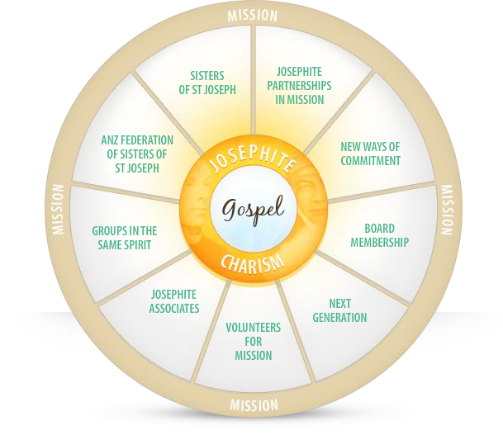
6.Dignity for all Life and Especially People who have Fewer Choices
Module 1: Josephite Charism/Values/Ethos
Partners in Mission
Josephite today, means much more than vowed Sisters of St Joseph.
Sisters encourage new voices to enter the melody. The charism may be indefinable, but it can be recognised.
First given to our Founders and the early Sisters, many people like ourselves rejoice in it today.
http://www.sosj.org.au/being-involved/index.cfm?loadref=55

Slide 106
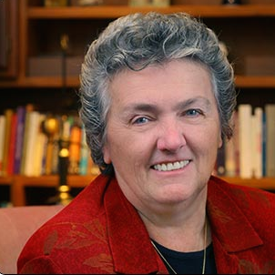
6.Dignity for all Life and Especially People who have Fewer Choices
Module 1: Josephite Charism/Values/Ethos
Videos
Joan Chittister OSB– interview
With Oprah
http://cta-usa.org/sr-joan-chittister-oprah/

Slide 107
6.Dignity for all Life and Especially People who have Fewer Choices
Module 1: Josephite Charism/Values/Ethos
Activity: attending the Spiritual moment
Listen to “Love and Justice” Kavisha Mazella –
[ For MAC Computers]

Slide 108
Dignity for all Life and Especially People who have Fewer Choices
Module 1: Josephite Charism/Values/Ethos
Activity: attending the Spiritual moment
Listen to “Love and Justice” Kavisha Mazella –
[For PC users]

Slide 109
6.Dignity for all Life and Especially People who have Fewer Choices
Module 1: Josephite Charism/Values/Ethos
Activity: attending the Spiritual moment
Listen to “Love and Justice” Kavisha Mazella –
Respond to the song by writing or drawing…

Slide 110
6. Dignity for all Life and Especially People who have Fewer Choices
Module 1: Josephite Charism/Values/Ethos
Questions for reflection
Shared and/or personal
Who are those with fewer choices within your sphere of influence?
How does your ministry/work cater for those with fewer choices?
How does the Josephite philosophy influence you to keep those with fewer choices in mind when making decisions in your workplace?

Slide 111
6.Dignity for all Life and Especially People who have Fewer Choices
Module 1: Josephite Charism/Values/Ethos
Something to pursue if you have an interest
Visit and or volunteer at an organisation that caters specifically for those with fewer choices or the environment:
Eg. St Vincent de Paul; Mission Australia;
Home of Compassion soup kitchen; Salvation Army Housing
Matt Talbot homes, Asylum Seekers and Refugee Resource Centres
Subscribe to Australian Catholics, Tui Motu, Resurgence, Earth song or Eureka Street
Make a regular donation to support those with fewer choices
Eg Caritas
Read - Creating a good society – Claire Andre and Manuel Velasquez http://www.scu.edu/ethics/publications/iie/v5n1/homepage.html
Visit www.earthsong.org.au or www.resurgence.org

Slide 112
6.Dignity for all Life and Especially People who have Fewer Choices
Module 1: Josephite Charism/Values/Ethos
Check your understanding
Possible options
Scenarios and choose the Josephite response – multiple choice quiz
Create a presentation for your staff group or a colleague
Create a visual representation of your learning
Write a poem/ song/ prayer or psalm

