Slide 1
NINE DAYS OF THANKSGIVING
The Sisters of St Joseph
give thanks for
150 years
1866 - 2016
Click to continue when ready

Slide 2
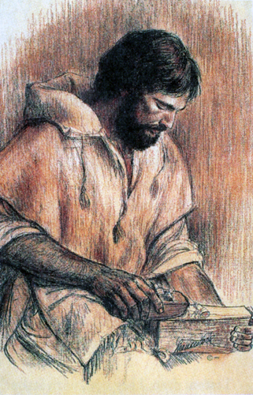
DAY
two
Click to continue when ready

Slide 3
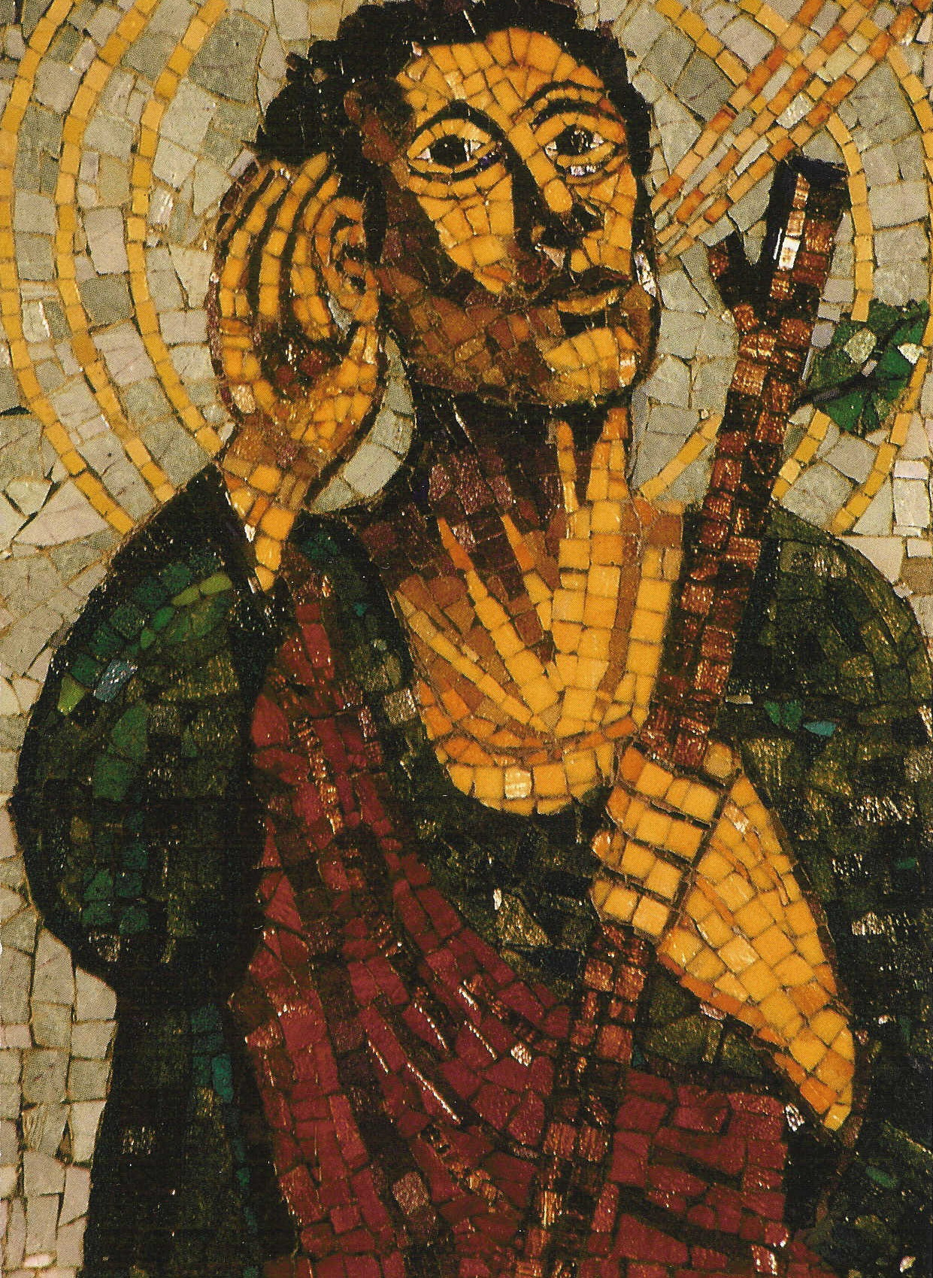
Joseph the attentive one
Click to continue when ready

Slide 4
WITH GRATEFUL HEARTS
Today we give thanks
for all who are attentive to the needs of our world and answer the call to respond.
Click to continue when ready

Slide 5
We are mindful
of St Joseph
who listened attentively
to God.
Click to continue when ready

Slide 6
Hear my words and apply your heart to my teachings. It will do you good to hide them in your heart and have them ready on your lips. Proverbs 22:17-18
Pray to be ever ready for God’s will, even when it takes you by surprise.
Mary MacKillop 1880
Let us do all we can to serve God.
Julian Tenison Woods 1875
Click to continue when ready

Slide 7
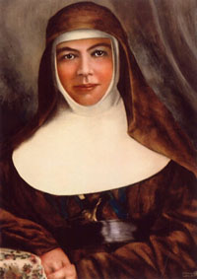
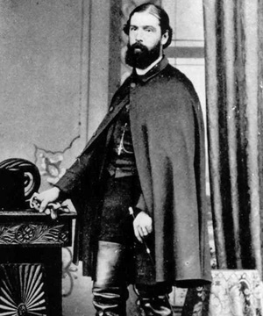
As you ponder the words from
the Book of Proverbs 22
and the writings of
Mary MacKillop 1880
& Julian Tenison Woods 1875,
what touches your heart?
Click to continue when ready

Slide 8
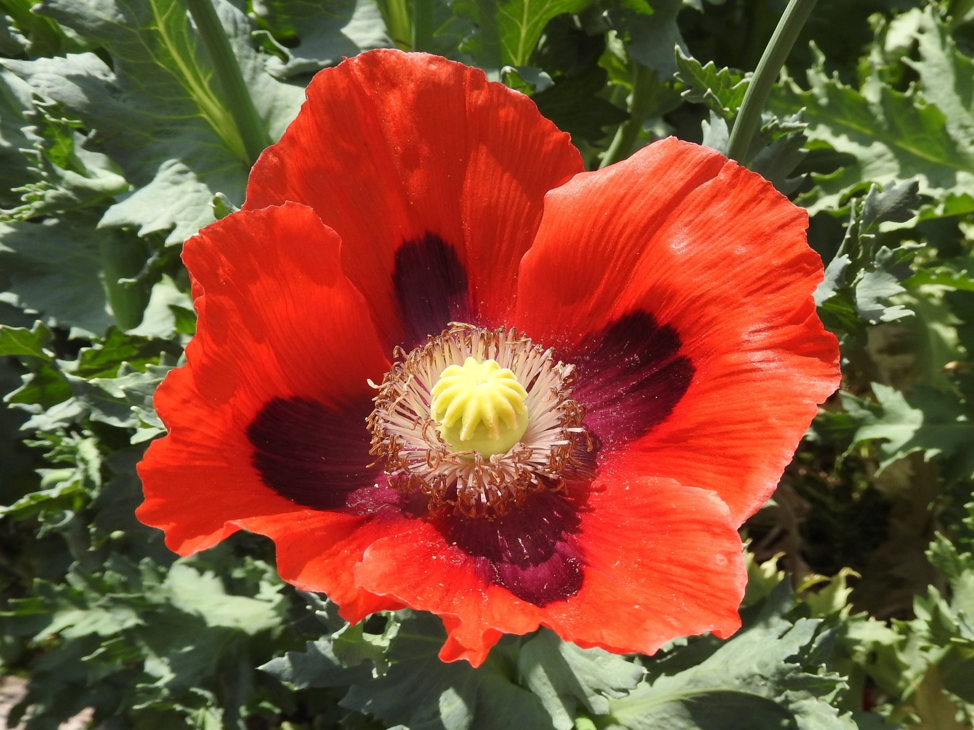
(Your name)
Be attentive to God
and to God’s desires
for our world.
Click to continue when ready

Slide 9
How is the mystery of God’s mission unfolding in your life?
(take as much time as you can to reflect on this)
Click to continue when ready

Slide 10
To what does this call me today?
Click to continue when ready

Slide 11
Attentive to God’s desires for our world,
we pray:
We give thanks for God’s generosity
in calling the Sisters of St Joseph into being.
For Mary MacKillop and Julian Tenison Woods
the first Sisters, the children in schools,
the families around them,
the friends supporting them.
For the vision, energy and legacy they left.
Click to continue when ready

Slide 12
We give thanks for the Josephite spirit in God’s mission
for the women who heeded,
the people who supported the mission,
the families who welcomed the Sisters.
For the love and healing in our parishes.
Join with us, all who have gone before
walking the Josephite way
supporting the Josephite vision
drawn into Josephite communion.
Join us in praise God’s abounding kindness.
Amen
Click to continue when ready

Slide 13
Thank you for praying in solidarity
with the Sisters of St Joseph
and people from across the world.
Let us remain mindful of St Joseph
who was attentive to God’s call.
We look forward to praying together tomorrow.
Click to continue when ready

Slide 14
Click to continue when ready

