Slide 1
NINE DAYS OF THANKSGIVING
The Sisters of St Joseph
give thanks for
150 years
1866 - 2016
Click to continue when ready

Slide 2
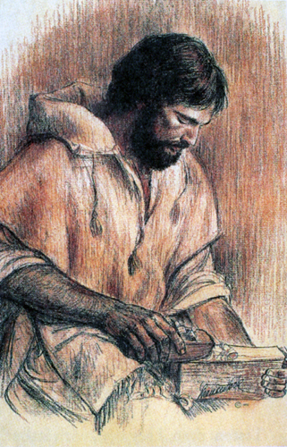
DAY
nine
Click to continue when ready

Slide 3
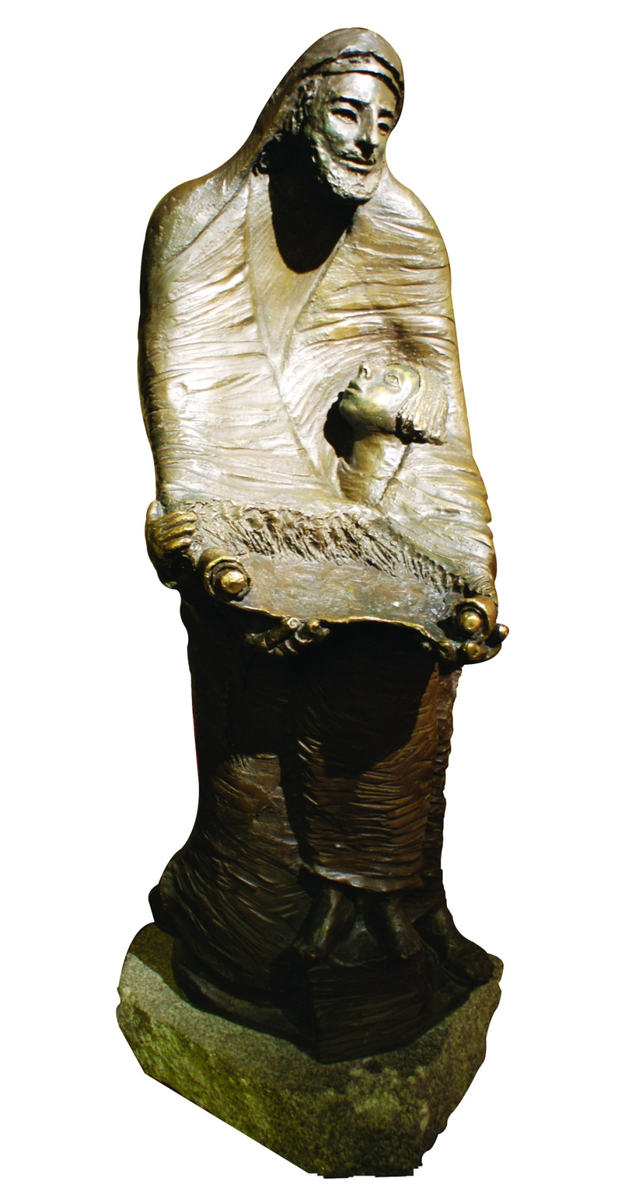
JOSEPH, STRONG AND SILENT
Click to continue when ready

Slide 4
WITH GRATEFUL HEARTS
Today we give thanks
for the Sisters who have gone before us.
Click to continue when ready

Slide 5
We are mindful
of St Joseph
the strong
& silent one.
Click to continue when ready

Slide 6
God will do the fighting for you,
you have only
to keep still and silent.
Exodus 14:14
…and in the wilderness, where you saw how the Lord your God carried you, just as one carries a child, all the way that you travelled until you reached this place.
Deuteronomy 1:31-32
Click to continue when ready

Slide 7
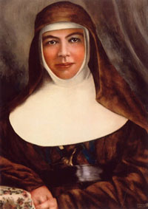
We know that St Joseph
was humble and hidden….
are we always as humble,
as retiring,
as modest as a child
of the lowly St Joseph should be?
Mary MacKillop 1893
Click to continue when ready

Slide 8
As you ponder the words from
the Books of Exodus & Deuteronomy
and the writings of Mary MacKillop,
what touches your heart?
Click to continue when ready

Slide 9
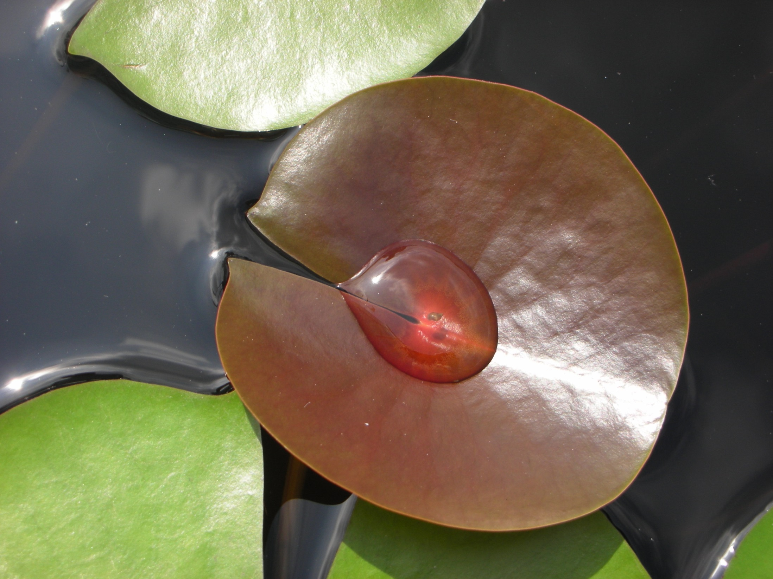
(Your name)
God has carried you to
where you are today,
listen to him.
Click to continue when ready

Slide 10
How is the mystery
of God’s mission
unfolding in your life?
(take as much time as you can to reflect on this)
Click to continue when ready

Slide 11
To what does this call me today?
Click to continue when ready

Slide 12
Mindful of the Sisters of St Joseph
who have gone before us,
we pray:
We give thanks for God’s generosity
in calling the Sisters of St Joseph into being.
For Mary MacKillop and Julian Tenison Woods
the first Sisters, the children in schools,
the families around them,
the friends supporting them,
For the vision, energy and legacy the left.
Click to continue when ready

Slide 13
We give thanks for the Josephite spirit in God’s mission
for the women who heeded,
the people who supported the mission,
the families who welcomed the Sisters,
For the love and healing in our parishes.
Join with us, all who have gone before
walking the Josephite way
supporting the Josephite vision
drawn into Josephite communion.
Join us in praise God’s abounding kindness.
Amen
Click to continue when ready

Slide 14
Thank you for praying in solidarity
with the Sisters of St Joseph
and people from across the world.
Let us remain mindful of St Joseph
the strong and silent one.
We ask your continued prayers
for the Sisters of St Joseph
as we continue to listen and respond
to the heartbeat of our world.
Click to continue when ready

Slide 15
Click to continue when ready

